Slide 1
Machine Learning
Clustering
Dinesh C

Slide 2
Affinity Propagation
Clustering Mechanism:
Affinity Propagation forms clusters by iteratively exchanging messages between pairs of samples until convergence.
Identifies a small number of exemplars, which are samples most representative of others in the dataset.
Message Updates:
Messages represent the suitability of one sample being the exemplar of another.
Updates are influenced by other pairs and iteratively processed until convergence.

Slide 3
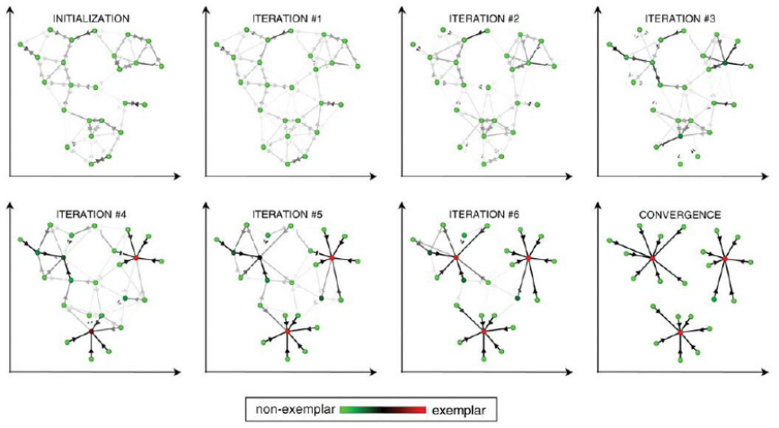
Final Output:
Post-convergence, exemplars are selected to define the final clustering.

Slide 4
Advantages:
Dynamically chooses the number of clusters based on the provided data.
Key parameters:
Preference: Determines the number of exemplars used.
Damping factor: Prevents numerical oscillations during message updates.
Limitations:
Time complexity: Of the order O(N²T), where N is the number of samples and T is the number of iterations.
Memory complexity: O(N2) when using a dense similarity matrix, but can be reduced with sparse matrices.
Best suited for small-to-medium-sized datasets due to computational demands.

Slide 5
MeanShift
Objective:
MeanShift clustering aims to identify blobs in a smooth density of samples.
Algorithm:
Centroid-based algorithm: Updates centroids to be the mean of points within a specified region.
Post-processing stage: Eliminates near-duplicate centroids to finalize the set.
Key Features:
Automatically determines the number of clusters.
Controlled by bandwidth, which sets the size of the region for centroid updates.
Bandwidth estimation: Can be set manually or estimated using the estimate_bandwidth function.

Slide 6
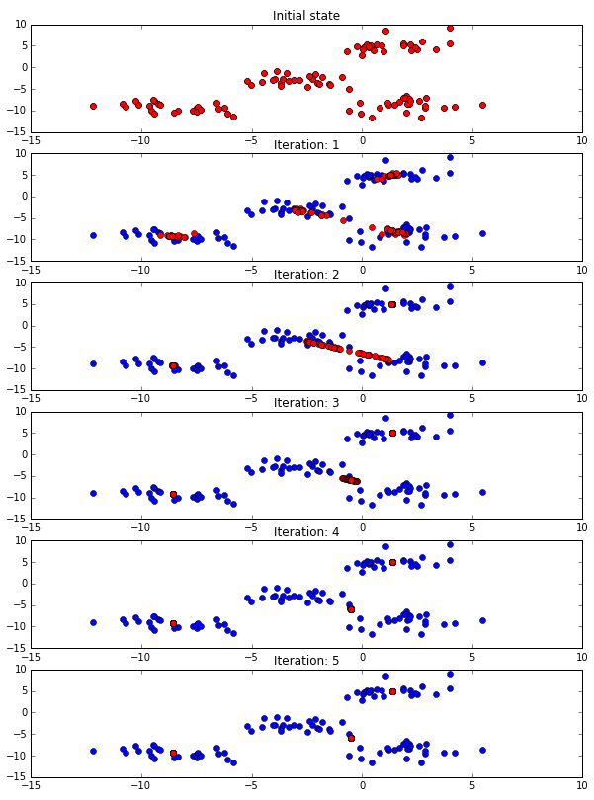

Slide 7
Scalability:
Not highly scalable due to multiple nearest-neighbor searches during execution.
Convergence:
The algorithm guarantees convergence.
Stops iterating when centroid changes become minimal.
Labelling New Samples:
Assigns a new sample to the nearest centroid.

Slide 8
Spectral clustering
Mechanism:
Performs low-dimensional embedding of the affinity matrix between samples.
Clusters the components of eigenvectors in this low-dimensional space (e.g., using KMeans).
Computational Efficiency:
Particularly efficient when:
The affinity matrix is sparse.
The amg solver is used for solving eigenvalue problems (requires the pyamg module).
Clusters:
Number of clusters must be specified in advance.
Works well for a small number of clusters; less effective for many clusters.

Slide 9
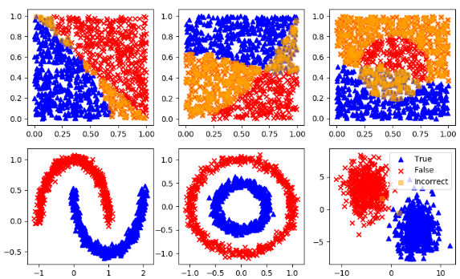

Slide 10
Special Case: Two Clusters:
Solves a convex relaxation of the normalized cuts problem on the similarity graph.
Cuts the graph into two parts, minimizing the weight of the edges cut relative to internal edge weights in each cluster.
Applications:
Particularly useful for images:
Graph vertices represent pixels.
Edge weights depend on the image gradient.

Slide 11
Advantages:
Scalability: Spectral clustering can handle large datasets and high-dimensional data, as it reduces the dimensionality of the data before clustering.
Flexibility: Spectral clustering can be applied to non-linearly separable data, as it does not rely on traditional distance-based clustering methods.
Robustness: Spectral clustering can be more robust to noise and outliers in the data, as it considers the global structure of the data, rather than just local distances between data points.
Disadvantages:
Complexity: Spectral clustering can be computationally expensive, especially for large datasets, as it requires the calculation of eigenvectors and eigenvalues.
Model selection: Choosing the right number of clusters and the right similarity matrix can be challenging and may require expert knowledge or trial and error.

Slide 12
DBSCAN
Cluster Identification:
DBSCAN views clusters as areas of high density separated by low-density regions.
Clusters can have arbitrary shapes, unlike KMeans, which assumes convex-shaped clusters.
Core Concept:
Core samples: Points in high-density areas.
Clusters:
Composed of core samples close to each other (defined by a distance measure).
Include non-core samples near a core sample but not classified as core samples themselves.

Slide 13
Parameters:
min_samples:
Defines the minimum number of samples within eps distance to form a dense area.
Controls tolerance for noise, higher values tolerate noisy data better.
eps:
Defines the local neighborhood around points.
Key parameter for clustering, crucial to choose based on data characteristics.
Cluster Formation:
A core sample has min_samples neighbors within eps distance, marking it as dense.
Recursive process to build clusters:
Starts with a core sample, finds its neighboring core samples, and continues expanding the cluster.
Non-core samples on the fringes of clusters remain part of clusters but do not contribute to further expansion.

Slide 14
Outliers:
Samples that are neither core samples nor within eps distance of any core sample are classified as outliers.
Parameter Challenges:
Setting eps correctly is critical:
Too small: Most data labeled as noise (-1).
Too large: Close clusters merge or entire data forms one cluster.
Heuristics for choosing eps include analyzing the nearest-neighbor distances plot.
Visualization:
Large circles represent core samples in clusters.
Smaller circles are non-core samples within clusters.
Black points signify outliers.

Slide 15
OPTICS
Similarity with DBSCAN:
Generalizes DBSCAN by allowing a range for eps instead of a single value.
Builds a reachability graph to assign:
Reachability distance.
Cluster ordering attribute.
Key Features:
Fits a model to determine cluster membership.
Performs DBSCAN-style cluster extraction in linear time using cluster_optics_dbscan.
Lower max_eps value results in shorter run times (maximum neighborhood radius).

Slide 16
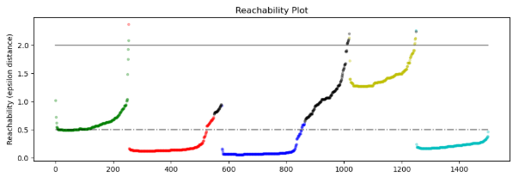

Slide 17
Reachability Distances & Clustering
Variable Density Clusters:
Combines reachability distances and dataset ordering to produce a reachability plot.
Y-axis: Point density.
X-axis: Points ordered to place adjacent ones nearby.
Cluster Extraction Options:
“Cutting” reachability plot at a value gives DBSCAN-like results:
Points above cut = noise.
Gaps signify new clusters.
Steep slopes define clusters (adjustable with xi parameter).
Hierarchical representations generated via reachability dendrograms.
Visualization Insights:
Hierarchical clusters detected accessible via cluster_hierarchy.
Cluster colors match corresponding reachability plot segments.
Blue and red clusters can be sub-clusters of a larger parent cluster.

Slide 18
BIRCH
Clustering Feature Tree (CFT):
Built to compress data into Clustering Feature Nodes (CF Nodes).
CF Nodes contain Clustering Feature Subclusters (CF Subclusters).
Non-terminal CF Nodes may have CF Nodes as children.
Clustering Feature Subclusters:
Hold essential information to avoid storing entire input data in memory:
Number of samples in the subcluster.
Linear Sum: n-dimensional vector summing all samples.
Squared Sum: Sum of squared L2 norms of all samples.
Centroids: Calculated as linear sum / n_samples.
Squared norm of centroids.

Slide 19
Key Parameters
Threshold: Limits the distance between incoming samples and existing subclusters.
Branching Factor: Caps the number of subclusters in a node.
Data Reduction Process
Input data reduced to subclusters derived from CFT leaves.
Reduced data processed further with a global clusterer:
n_clusters parameter:
Set to None: Directly reads subclusters from leaves.
Specified value: Performs global clustering to label subclusters and map samples

